Slide 1
OPEN-DATA SEARCH
Deepti R Siddagangappa -1716400396
Kavya Sethuraman -7852999061
Rasika Guru - 4615679320

Slide 2
INTRODUCTION
Responsive web application, for searching public datasets from different sources like UCI ML Repository, Kaggle etc.
Maintain only metadata of these datasets and not the datasets itself.
Upon login, Users will be able to add their datasets.
Users can up-vote/down-vote on existing datasets and share their analysis on the datasets
Datasets with lot of down votes would be removed.

Slide 3
ARCHITECTURE
Elastic Search DB
Application front-end client
Google Firebase (User Auth, hosting)
S3 Storage
Google Firebase (Authentication, User Database, Hosting)
Elastic Search (Search Database either on Google Cloud Engine or on AWS)
Amazon S3 to store user uploaded datasets

Slide 4
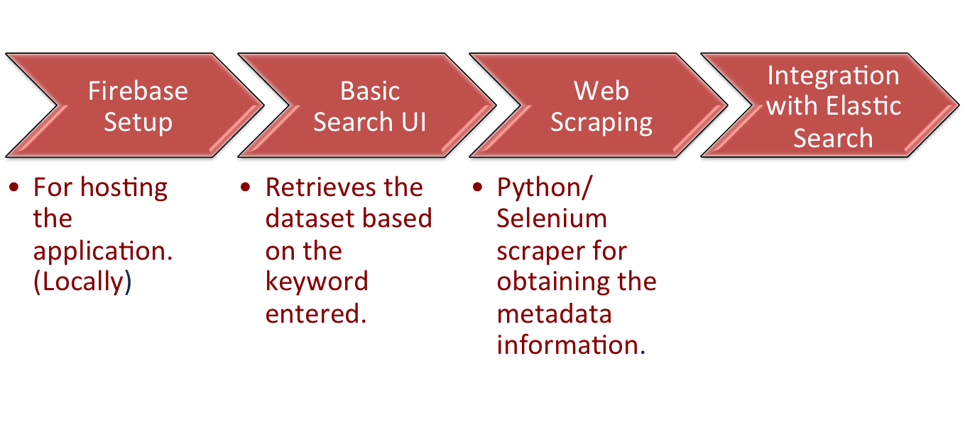
PROGRESS
Elastic search integration using jQuery browser build.

Slide 5
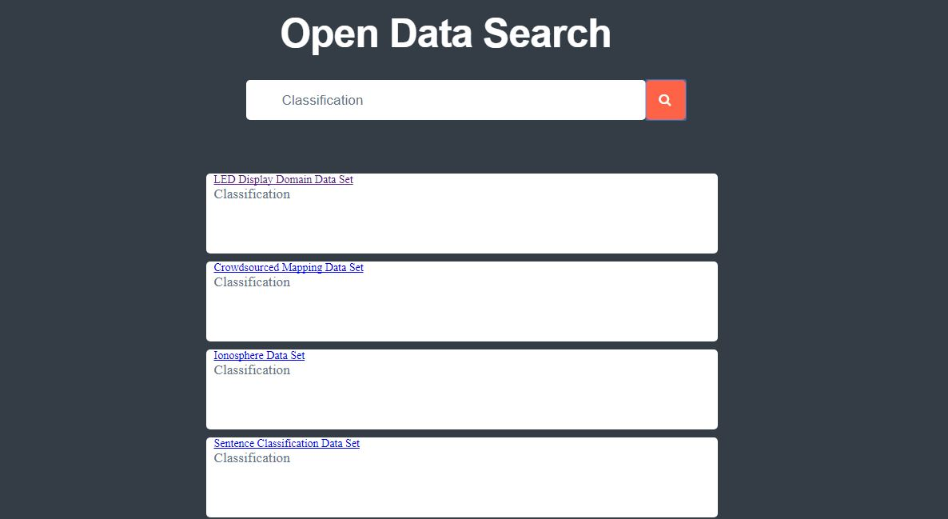

Slide 6
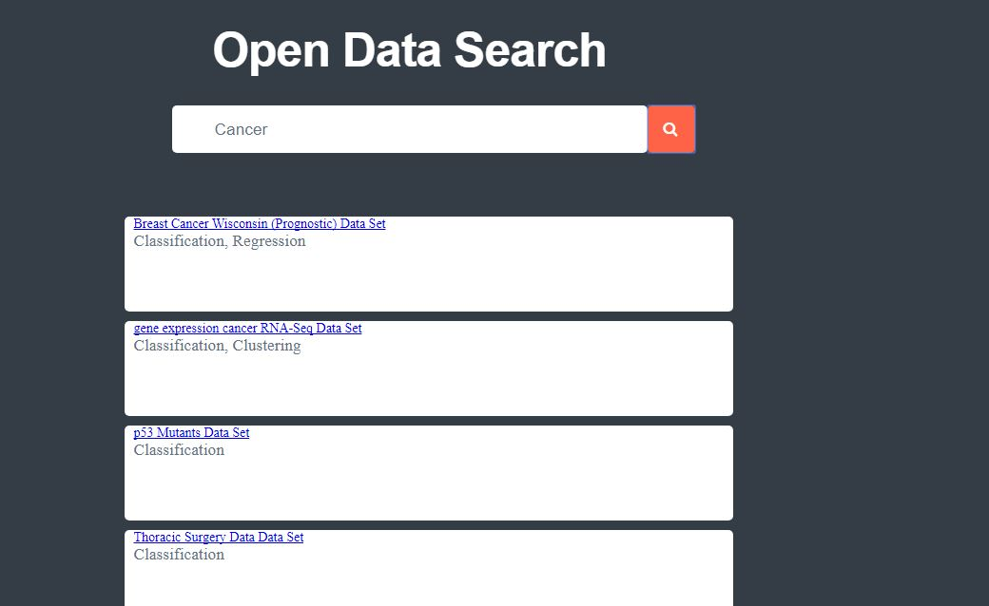

Slide 7
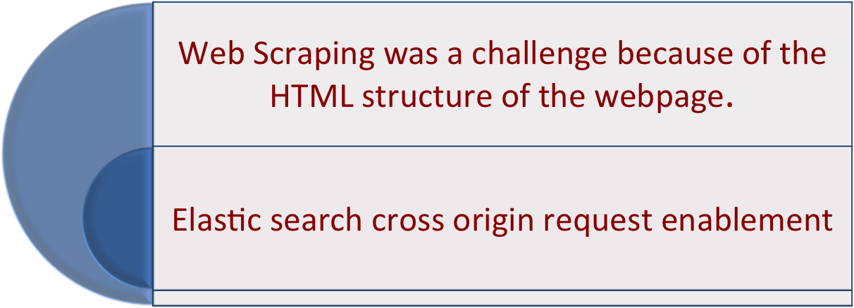
CHALLENGES

Slide 8
TO-DO
User Authentication
User Management(Upvote/Downvote for the Datasets)
User Dataset Upload

Slide 9
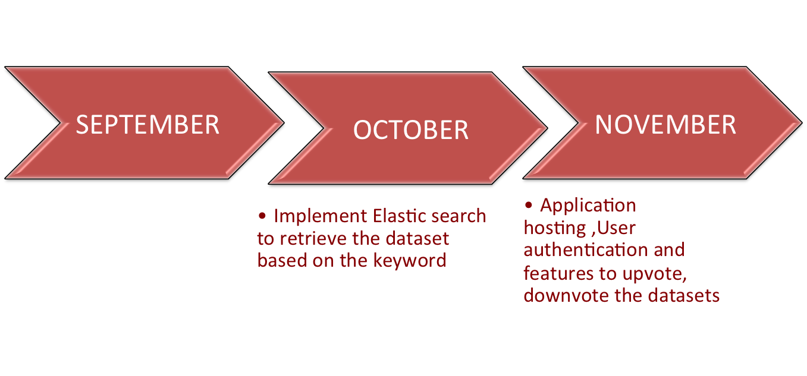
TIMELINE
  Front end development and scrap the metadata from website

